Slide 1
Making Disability Insurance Affordable
Michael Sato

Slide 2
Agenda
Why do people need income protection?
What is disability insurance
Alternatives to disability insurance
Short Term Disability Insurance
Accident Only Disability Insurance
Accidental Death Life Insurance with Accidental Disability Insurance Rider
Disability Insurance Rider on Term Insurance
Critical Illness Insurance
Questions?

Slide 3
Why do people need income protection?
What is your most important asset?

Slide 4
Why do people need income protection?
Your ability to earn a living

Slide 5
Why do people need income protection?
One in four 20-year-olds will experience a disability for 90 days or more before they reach 67 (Social Security Administration)
You and your loved ones are dependent on your ability to earn a paycheck

Slide 6
What can happen if disability strikes?
Notes:
How will you meet the expenses of a disability, just at the time your income ceases?
Getting sick or hurt can be expensive! According to a study published by the Kaiser Family Foundation, "about a quarter (26%) of U.S. adults ages 18-64 say they or someone in their household has problems paying or an inability to pay medical bills in the past 12 months." In addition, according to the study, "insurance is not a panacea...roughly one in five of those with health insurance report problems paying medical bills." Source: The Burden of Medical Debt; Kaiser Family Foundation; January 2016

Slide 8
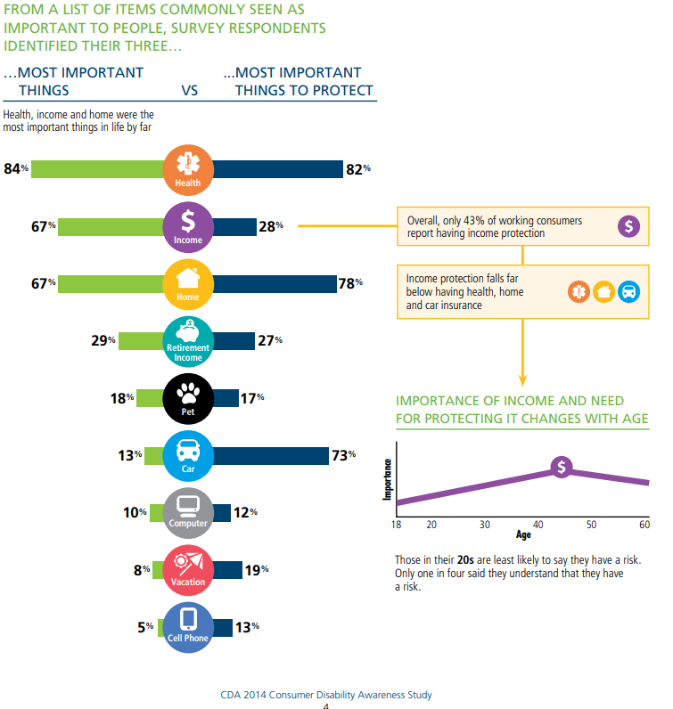

Slide 9
What is Disability Insurance?
DI is an agreement made between an insurance company and the policyholder
In exchange for the monthly payments you make, the insurance company agrees to pay you a monthly benefit amount if you suffer a disability that affects your ability to work
Designed to replace a percentage of the income you lose due to not being able to work

Slide 10
How it works An adequate amount of personally-owned DI, coordinated with other sources of income, can guarantee a source of income in the event of serious illness or injury.

Slide 15
Alternatives to “Regular” Disability Insurance
Short Term Disability Insurance
Accident Only Disability Insurance
Accidental Death Life Insurance with Accidental Disability Insurance Rider
Disability Insurance Rider on Term Insurance
Critical Illness Insurance

Slide 16
Short Term Disability Insurance (Assurity Income Protection Disability Insurance)
Short term disability insurance with a benefit period of two years or less (13 weeks, 26 weeks, 1-year, 2-year
Benefit pays out weekly
If paid with post-tax dollars, benefit is tax free
Max weekly benefits for Self-Employed is $50-$600
Max weekly benefits for W-2 Employees is $50-$1,000
No income verification
No medical exams
Notes:
Proceeds can be used to pay for mortgage, rent payments, health insurance deductibles, coinsurance and/or co-payments, costs of receiving out-of-network medical treatment, including possible travel and lodging expenses, treatments not covered by traditional health insurance, child care expenses during treatment or hospitalization, modifications to your home or vehicle, short term home health care.

Slide 17
Assurity Income Protection Disability Insurance 35 year old female, $500/month weekly benefit, 14 day elimination period, 3A
Notes:
Proceeds can be used to pay for mortgage, rent payments, health insurance deductibles, coinsurance and/or co-payments, costs of receiving out-of-network medical treatment, including possible travel and lodging expenses, treatments not covered by traditional health insurance, child care expenses during treatment or hospitalization, modifications to your home or vehicle, short term home health care.

Slide 18
Assurity Income Protection Disability Insurance 35 year old male, $500/month weekly benefit, 14 day elimination period, 3A
Notes:
Proceeds can be used to pay for mortgage, rent payments, health insurance deductibles, coinsurance and/or co-payments, costs of receiving out-of-network medical treatment, including possible travel and lodging expenses, treatments not covered by traditional health insurance, child care expenses during treatment or hospitalization, modifications to your home or vehicle, short term home health care.

Slide 19
Accident Only Disability Insurance (Assurity Income Protection Accident Only Disability Insurance)
Short term disability insurance is a disability insurance policy with a benefit period of two years or less (13 weeks, 26 weeks, 1-year, 2-year
Benefit pays out weekly
If paid with post-tax dollars, benefit is tax free
Max weekly benefits for Self-Employed is $50-$600
Max weekly benefits for W-2 Employees is $50-$1,000
No income verification
No medical exams
Notes:
Proceeds can be used to pay for mortgage, rent payments, health insurance deductibles, coinsurance and/or co-payments, costs of receiving out-of-network medical treatment, including possible travel and lodging expenses, treatments not covered by traditional health insurance, child care expenses during treatment or hospitalization, modifications to your home or vehicle, short term home health care.

Slide 20
Assurity Income Protection Accident Only Disability Insurance 35 year old female, $500/month weekly benefit, 14 day elimination period, 3A
Notes:
Proceeds can be used to pay for mortgage, rent payments, health insurance deductibles, coinsurance and/or co-payments, costs of receiving out-of-network medical treatment, including possible travel and lodging expenses, treatments not covered by traditional health insurance, child care expenses during treatment or hospitalization, modifications to your home or vehicle, short term home health care.

Slide 21
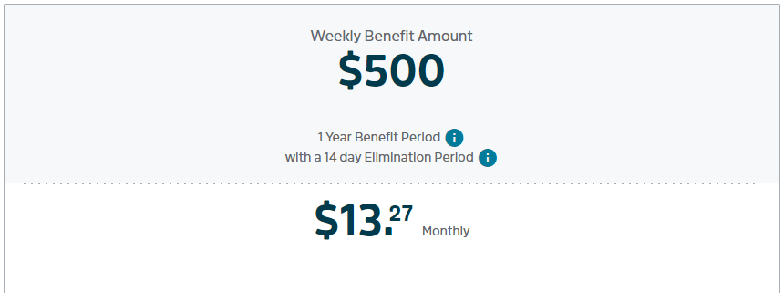
Assurity Income Protection Accident Only Disability Insurance 35 year old male, $500/month weekly benefit, 14 day elimination period, 3A
Notes:
Proceeds can be used to pay for mortgage, rent payments, health insurance deductibles, coinsurance and/or co-payments, costs of receiving out-of-network medical treatment, including possible travel and lodging expenses, treatments not covered by traditional health insurance, child care expenses during treatment or hospitalization, modifications to your home or vehicle, short term home health care.

Slide 22
Accidental Death Life Insurance with Accidental Disability Insurance Rider (Assurity Accidental Death Plus)
Pays when an accidental death results from any covered accident
Guaranteed renewable to age 80 or term periods of 5, 7,10, 15, 20, or 30 years
Benefit amounts from $5,000-$350,000
Disability rider
Elimination period-90 days
Benefit Period-2 years
Maximum issue is lesser of $3,000/month or 1.5% of base policy
Notes:
Proceeds can be used to pay for mortgage, rent payments, health insurance deductibles, coinsurance and/or co-payments, costs of receiving out-of-network medical treatment, including possible travel and lodging expenses, treatments not covered by traditional health insurance, child care expenses during treatment or hospitalization, modifications to your home or vehicle, short term home health care.

Slide 23
Assurity Accidental Death Insurance Plus 35 year old female, $250,000, To Age 80, $3,000 month Accident-Only Disability Income Rider 90 day elimination period, 2 years benefit period, 3A
Notes:
Proceeds can be used to pay for mortgage, rent payments, health insurance deductibles, coinsurance and/or co-payments, costs of receiving out-of-network medical treatment, including possible travel and lodging expenses, treatments not covered by traditional health insurance, child care expenses during treatment or hospitalization, modifications to your home or vehicle, short term home health care.

Slide 24
Assurity Accidental Death Insurance Plus 35 year old male, $250,000, To Age 80, $3,000 month Accident-Only Disability Income Rider 90 day elimination period, 2 years benefit period, 3A
Notes:
Proceeds can be used to pay for mortgage, rent payments, health insurance deductibles, coinsurance and/or co-payments, costs of receiving out-of-network medical treatment, including possible travel and lodging expenses, treatments not covered by traditional health insurance, child care expenses during treatment or hospitalization, modifications to your home or vehicle, short term home health care.

Slide 25
Disability Insurance on Term insurance (Assurity Start Smart)
Term Life Insurance with 10, 15,20, and 30 years
Accelerated underwriting up to $1 million for ages 18-50
Up to $500,000 for ages 51-65
Critical Illness Benefit rider for ages 18-65 and benefit amount of $20,000-$100,000 (not to exceed base policy benefit amount)
Monthly Disability rider for ages 18-60 with elimination period of 90 days with benefit period of 2 yrs
Benefit amount of $300 through lessor of $3000 or 1.5% of base policy, also limited to 60% of applicant’s gross earned monthly income
Notes:
Proceeds can be used to pay for mortgage, rent payments, health insurance deductibles, coinsurance and/or co-payments, costs of receiving out-of-network medical treatment, including possible travel and lodging expenses, treatments not covered by traditional health insurance, child care expenses during treatment or hospitalization, modifications to your home or vehicle, short term home health care.

Slide 26
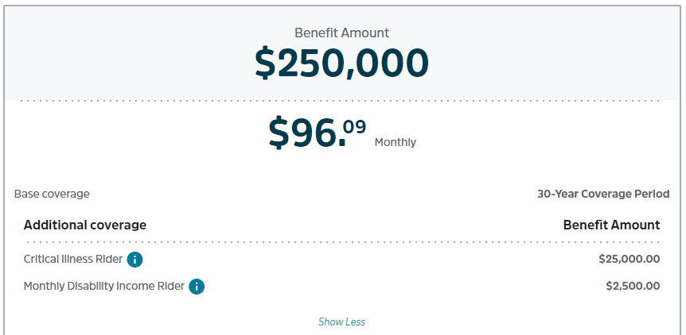
Assurity Start Smart , 35 year old female, $250,000 30-year term, $25,000 critical illness rider, $2,500 month-2 years monthly disability income rider, Preferred Non-tobacco
Notes:
Proceeds can be used to pay for mortgage, rent payments, health insurance deductibles, coinsurance and/or co-payments, costs of receiving out-of-network medical treatment, including possible travel and lodging expenses, treatments not covered by traditional health insurance, child care expenses during treatment or hospitalization, modifications to your home or vehicle, short term home health care.

Slide 27
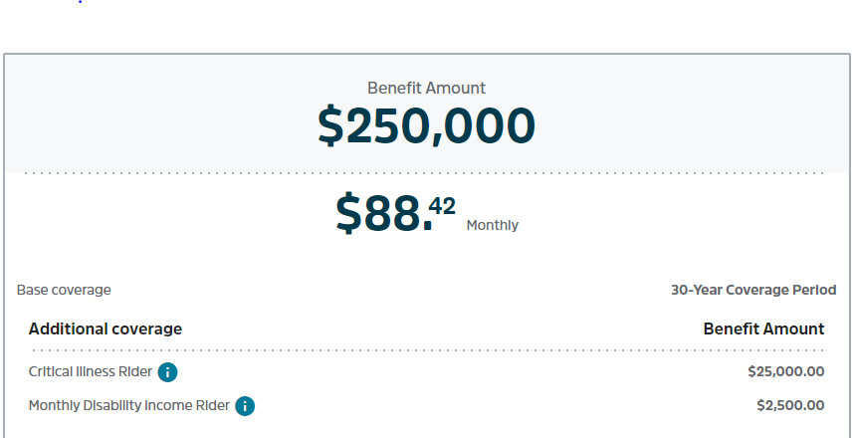
Assurity Start Smart , 35 year old male, $250,000 30-year term, $25,000 critical illness rider, $2,500 month-2 years monthly disability income rider, Preferred Non-tobacco
Notes:
Proceeds can be used to pay for mortgage, rent payments, health insurance deductibles, coinsurance and/or co-payments, costs of receiving out-of-network medical treatment, including possible travel and lodging expenses, treatments not covered by traditional health insurance, child care expenses during treatment or hospitalization, modifications to your home or vehicle, short term home health care.

Slide 28
Critical illness insurance
CII pays you a lump sum of money upon diagnosis of a covered condition. The money is yours to use for any purpose, with no restrictions.
Helps you survive financially while physically recovering from a serious illness
Covered Conditions include: heart attack, coronary artery bypass surgery, angioplasty, stroke, invasive cancer, non-invasive cancer, kidney (renal) failure, major organ transplant, advanced Alzheimer’s disease, paralysis, coma
Simplified underwriting benefit amounts from $5,000-$75,000
Benefit amount reduced by 50% at age 70
Renewability guaranteed for life
Notes:
Proceeds can be used to pay for mortgage, rent payments, health insurance deductibles, coinsurance and/or co-payments, costs of receiving out-of-network medical treatment, including possible travel and lodging expenses, treatments not covered by traditional health insurance, child care expenses during treatment or hospitalization, modifications to your home or vehicle, short term home health care.

Slide 29
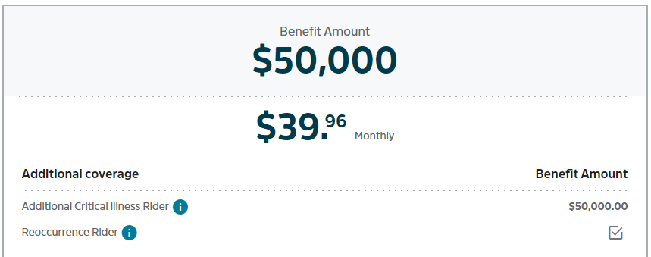
Assurity Critical Illness Insurance , 35 year old female, $50,000, Additional Critical Illness rider, Reoccurance rider, Non-tobacco
Notes:
Proceeds can be used to pay for mortgage, rent payments, health insurance deductibles, coinsurance and/or co-payments, costs of receiving out-of-network medical treatment, including possible travel and lodging expenses, treatments not covered by traditional health insurance, child care expenses during treatment or hospitalization, modifications to your home or vehicle, short term home health care.

Slide 30
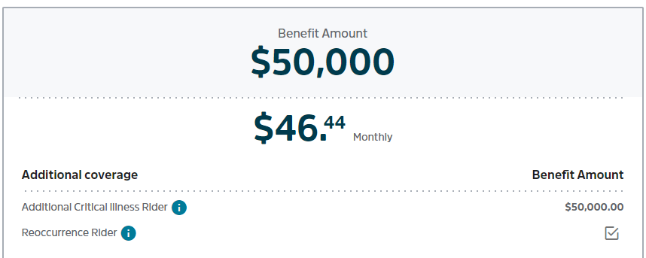
Assurity Critical Illness Insurance , 35 year old female, $50,000, Additional Critical Illness rider, Reoccurance rider, Non-tobacco
Notes:
Proceeds can be used to pay for mortgage, rent payments, health insurance deductibles, coinsurance and/or co-payments, costs of receiving out-of-network medical treatment, including possible travel and lodging expenses, treatments not covered by traditional health insurance, child care expenses during treatment or hospitalization, modifications to your home or vehicle, short term home health care.

Slide 31
Any Questions?

Slide 32
Thank you!
Michael Sato
msato@askoxy.com
(808) 527-8869

